Slide 1


An Action Handbook For STF

Slide 2
The Climate Crisis is Here
Because of a build up of greenhouse gases caused by reckless burning of fossil fuels,
The 20 hottest years on record have occurred in the past 22 years.
We are at risk of losing about half of land-based species in this century alone.
Climate related extreme weather events have cost us many lives and over $150 billion in one year.
97%
Of climate experts agree humans are causing global warming
Notes:
For some quick background, greenhouse gases as building up in our atmosphere, and that’s causing the Earth to warm, and plants, animals and even people to die. The future of our generation is literally on the line.

Slide 3

What are Fossil Fuels?
Fossil Fuels: A general term for organic materials that have been converted to crude oil, coal, natural gas, or heavy oils by exposure to heat and pressure in the Earth's crust over millions of years. (EPA)
When fossil fuels are burned, they release carbon dioxide and other greenhouse gases, which in turn trap heat in our atmosphere, making them primary contributors to global warming and climate change. (National Geographic)
Notes:
(read slide)

Slide 4
Must we change? Yes.
Can we change? Yes.
Will we change? It’s up to us.
Notes:
So it’s clear from that that yes, we have to change. And yes, we can change, we already have the solutions at hand: like solar and wind power. The question is: will we change. And that’s what I’m here to talk about.

Slide 5
Why Schools?
As the climate crisis worsens, young people like us will be affected the most and are already leading the global fight against climate change.
We have the power to make real change at our own schools.
Students are their most important constituent.
Notes:
(read slide)

Slide 6
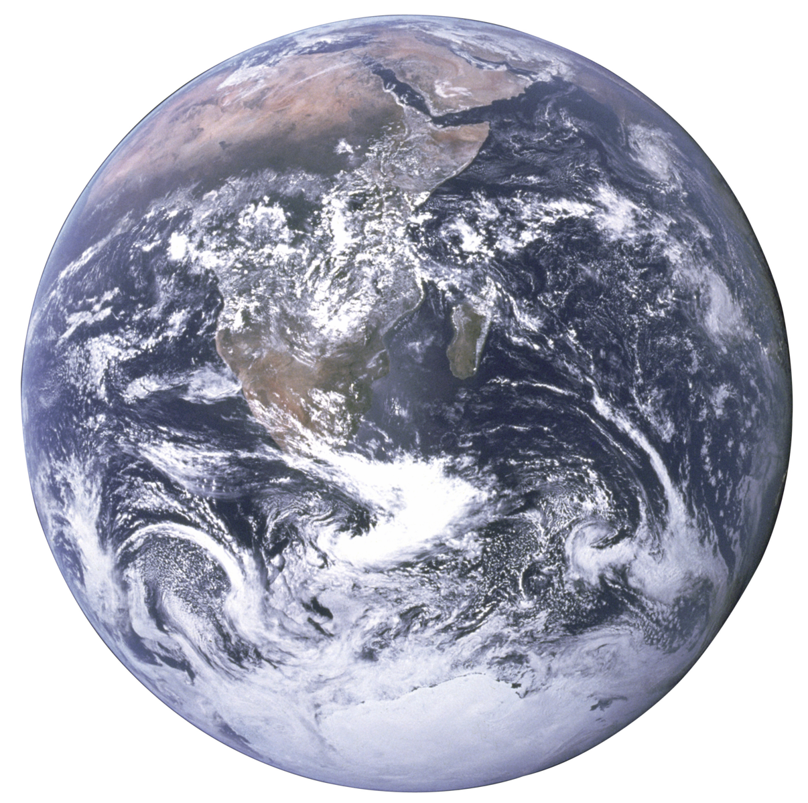
Green schools save money...
K-12 school districts in America spend $8 billion on energy each year.
LAUSD is the L.A. Department of Water and Power's single-largest customer.
Notes:
LAUSD’s 60 million square feet of roof space can and should be used to make money that can be reinvested in to classrooms and students.
Source: Laist

Slide 7
...and the planet
Schools are among the largest energy consumers in a community.
Schools that commit to clean renewable energy empower students to participate in civic engagement.
Notes:
(read slide)

Slide 8
5,500
5,500 American schools have already started moving to clean renewable energy.
That’s enough to power 190,000 households.
Imagine the impact we could have if all schools transitioned to renewable energy.
Notes:
(read slide)

Slide 9
10 steps to get your school green:
Notes:
Now in to the main segment of this presentation...

Slide 10
Mission Statement
[School Name] must commit to energy efficiency, transition to 100% clean renewable energy sources (solar, wind, geothermal), and focus on environmental justice and equity by [a specific date]
Most schools aim for no later than 2030.
You don’t have to have all the details yet, just know your goal.
Step
1
10
Notes:
The first step is developing am mission statement. Pretty straightforward, but this is super important so you have a clear goal in mind throughout the process. Here’s an example...

Slide 11
Find Allies
Committed allies will keep you going. They are essential. You will need…
Peer allies (we’ve seen a lot of success with environmental clubs, even if you’re not part of one it’s still good to reach out!)
Adult allies (example: motivated parents, school alumni, PTA, Booster Club)
Allies “inside the system” (example: teachers or administrators)
Local non-profits or renewable energy group with similar goals
You will need to continually build your network, but this is a good start.
Step
Step
Step
2
10
3
Notes:
(read slide) If you have an LAUSD chapter already in place, then you’re already well on your way with this step

Slide 12
Identify Important People
These are the people you will have to convince. No need to contact them yet, but it’s good to know who they are and how inclined they might be to support you.
Decision Makers:
Administration (Principal, Dean, etc.)
School Governance Committee
Implementers:
Facilities Manager
Sustainability Director (If you have one)
Step
Step
Step
2
3
3
10

Slide 13
Note: The following steps could be happening simultaneously
Notes:
This might seem like a linear process, but it’s not. It’s gonna be messy, and that’s okay.

Slide 14
Build Understanding
Find out what has happened or is happening with renewable energy at your school and at the district level. This might require some persistence.
Some questions you’ll want to ask...
– Have there been renewable energy programs at your school in the past? If so, how successful have they been?
– Does your school district have a plan for your school to transition to renewable energy yet?
Step
Step
Step
Step
4
10

Slide 15
Contact Decision Makers
Great job! You’ve made it this far. Now it’s time to get input from key decision makers.
Reach out to a decision maker (school board or administration). Find someone who shares your vision of a green school and talk to them about your progress so far.
Step
Step
Step
Step
Step
Step
Step
Step
5
10

Slide 16
Meeting With Facilities
Hopefully now you have a decision maker on your side, at least in theory.
Schedule a meeting with the Sustainability Director and/or Facilities Manager.
You don’t have to know everything, you can just listen and learn, focusing on your goal of 100% renewable energy.
Step
Step
Step
Step
Step
Step
Step
6
10
Notes:
Hopefully now you have a decision maker on your side, at least in theory, even if they haven’t committed to anything on papers.

Slide 17
Build Community Support
It
Reach out to community members (teachers, parents, students and other community leaders)! Get broad community support through news coverage, petitions, rallies, etc.
Also start to reach out to community organizations that might be interested in helping, especially environmental justice (EJ) groups.
Note: This seems like the simplest step, but it might take the most effort. Also, it’s okay if you are still completing other steps at the same time.
Step
Step
Step
Step
Step
Step
Step
Step
Step
Step
7
Notes:
This is beyond main allies

Slide 18
Go to Decision Makers
It
Now you have...
Strong allies that support you
An understanding of your school’s energy situation
A relationship with a key decision maker and facilities personnel
And broad community support
It’s time to take your proposal to the decision makers. If they are skeptical, you can remind them of your broad coalition including parents, teachers, students and community leaders.
It might take some pushing, but be persistent and change will happen!
Step
Step
Step
Step
Step
Step
Step
Step
Step
Step
Step
8

Slide 19
Pushing Decision Makers
It
Decision Makers still skeptical? You can try...
Holding a town hall
Gather an online petition
Organize a strategic protest or demonstration of support.
Reaching out to local journalists/press
Step
Step
Step
Step
Step
Step
Step
Step
Step
Step
Step
9

Slide 20
Staying Engaged
It
After you’ve celebrated your win, there is still work to be done.
Set up a task force for students and adults to...
Monitor the implementation to make sure it runs smoothly.
Ensure that it follows the determined timeline, and schedule updates.
Continue educating the community about climate change.
Step
Step
Step
Step
Step
Step
Step
Step
Step
10
12
Step
Step
3
11
10
3
3
4
4
4
5
5
5
6
7
7
8
2
3
8
9
3
3
3
4
4
4
5
5
5
7
7
7
8
8
9
3
9
3
4
4
5
5
7
8
9

Slide 21
Roles for Everyone!
After you’ve celebrated
You may be asking yourself, what role can I play in this effort? We need EVERYONE to be involved! Here are some ideas to get you started:
Presenters and speakers
Researchers
Outreach/Communications managers
Social media managers
Graphic designers
Petition managers
Notetakers
And more!
After you’ve celebrated

Slide 22
Sources
Slide 2
¹ WMO climate statement: past 4 years warmest on record. World Meteorological Organization. (2020). Retrieved 11 June 2020, from https://public.wmo.int/en/media/press-release/wmo-climate-statement-past-4-years-warmest-record.
² McKie, R. (2017). Biologists think 50% of species will be facing extinction by the end of the century. The Guardian. Retrieved 11 June 2020, from https://www.theguardian.com/environment/2017/feb/25/half-all-species-extinct-end-century-vatican-conference.
³ Billion-Dollar Weather and Climate Disasters: Overview. National Center for Environmental Information. (2020). Retrieved 11 June 2020, from https://www.ncdc.noaa.gov/billions/.
⁴ Scientific Consensus: Earth's Climate is Warming. (2020, January 21). Retrieved June 13, 2020, from https://climate.nasa.gov/scientific-consensus/
Slide 6
¹ U.S. Environmental Protection Agency. (2011). ​Energy Efficiency Programs in K-12 Schools: A Guide to Developing and Implementing Greenhouse Gas Reduction Programs.​ U.S. Environmental Protection Agency State and Local Climate and Energy Program. Retrieved December 20, 2017, from https://www.epa.gov/sites/production/files/2017-06/documents/k-12_guide.pdf
Slide 8
¹ The Solar Foundation, Generation 180 and the Solar Energy Industries Association, 2017.

